Slide 1


Using LinkedIn for Your Job Search
Transition Assistance webinar
Talent, Deloitte Services LP

Slide 2
Agenda
What is Linked In?
Build Your Profile
Build/Expand Your Network
Job Searching

Slide 3
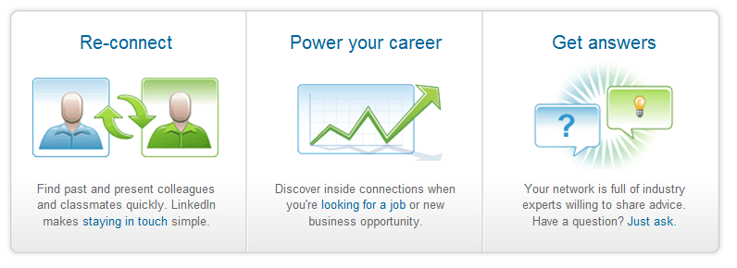
What is LinkedIn?
LinkedIn is an interconnected network of experienced professionals from around the world, representing 250 million members in over 200 countries.
You can find, be introduced to, and collaborate with qualified professionals that you need to work with to accomplish your goals.
LinkedIn is free to join.
They also offer a premium version of your accounts that give you more tools for finding and reaching the right people, whether or not they are in your network.

Slide 4
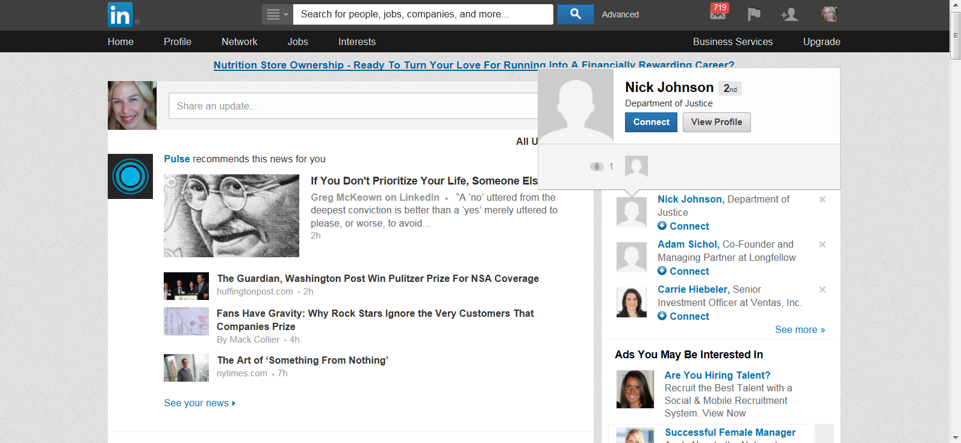
LinkedIn Home Page – Options

Slide 5
Agenda
What is Linked In?
Build Your Profile
Build/Expand Your Network
Job Searching

Slide 6
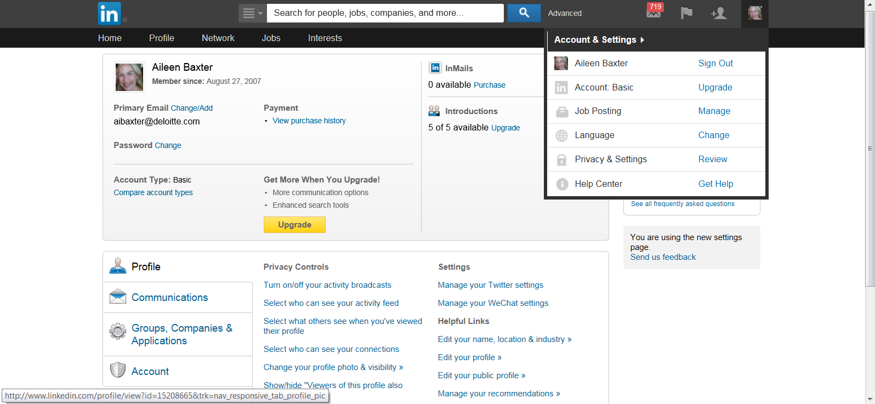
Settings

Slide 7
Building Your Profile Page
  Your LinkedIn profile is your opportunity to showcase your skills and talents. You can help the “right” people and opportunities find their way to you and you to them. Users with completed profiles are 40 times more likely to receive opportunities through LinkedIn.
Upload a professional picture
Enter relevant past employment. Provide details, accomplishments, key words,
Include certifications
Download the Box.net application to attach a copy of your resume
Update your profile and refresh “what are you doing now”
Highlight community involvement activities and professional blogs

Slide 8
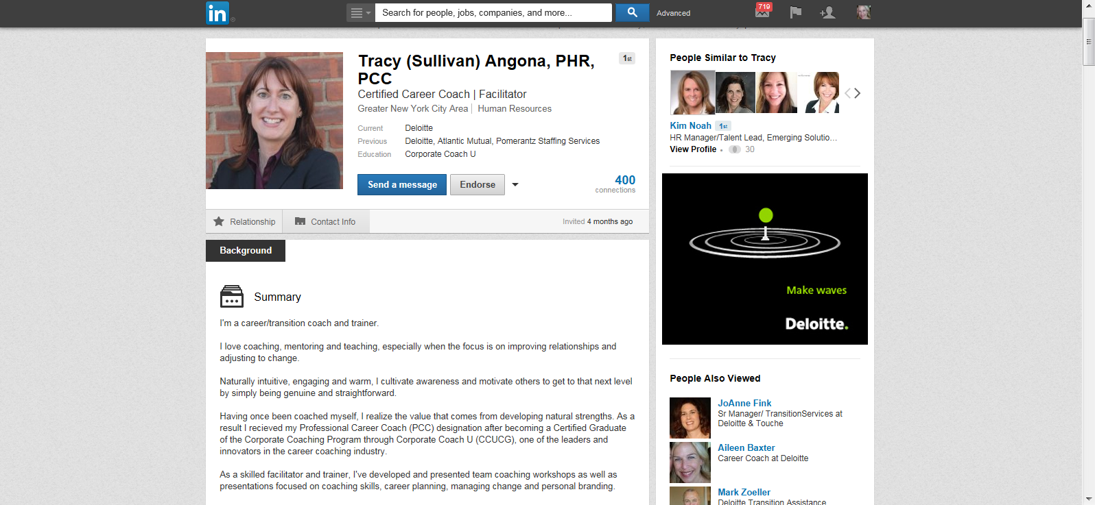
Sample Profile

Slide 9
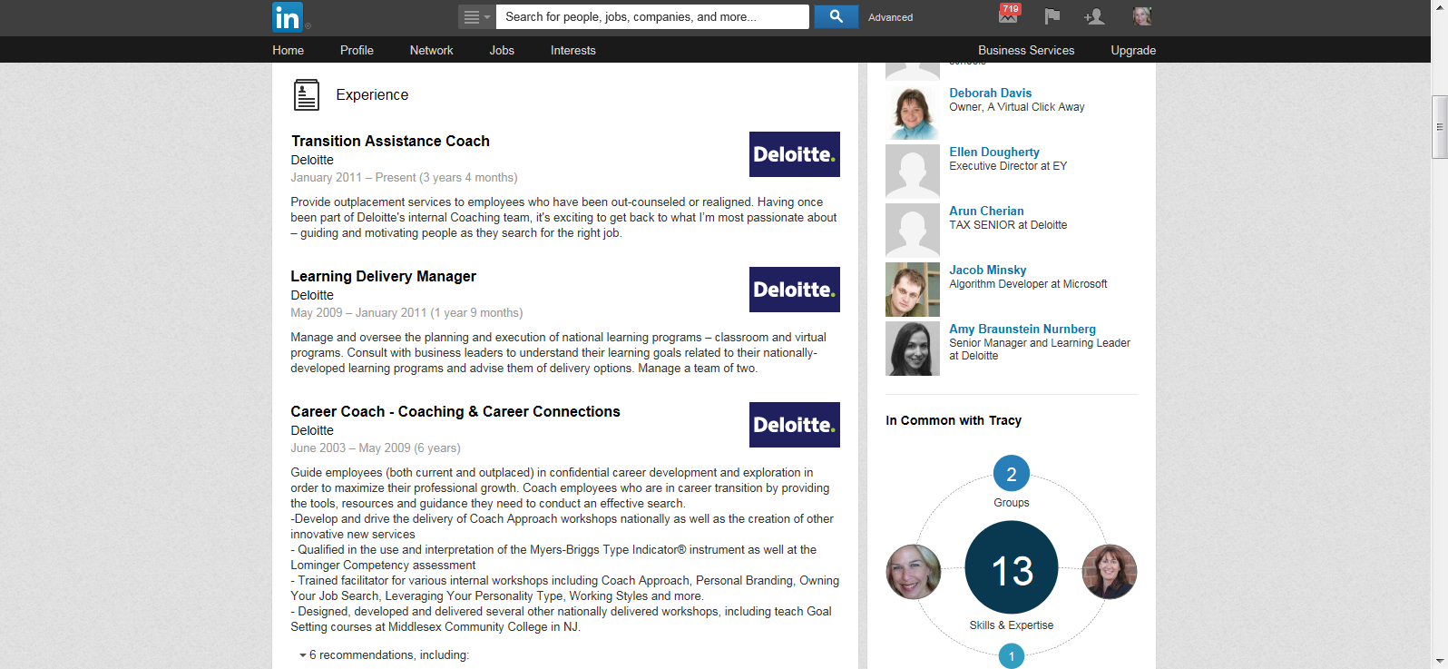
Sample Profile (cont’d)

Slide 10
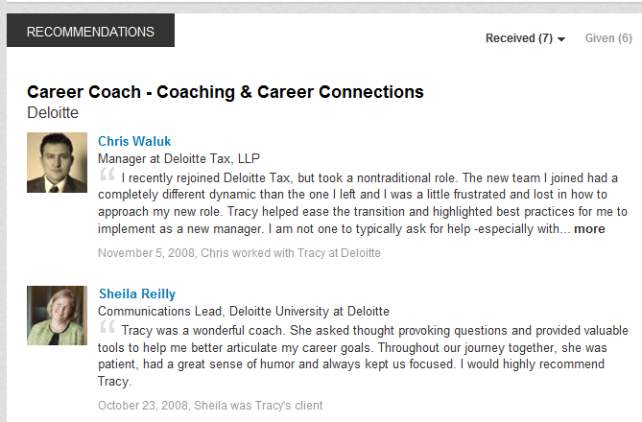

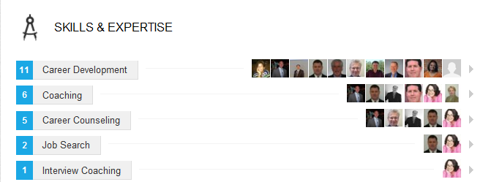
Recommendations & Endorsements

Slide 11
Agenda
What is Linked In?
Build Your Profile
Build/Expand Your Network
Job Searching

Slide 12
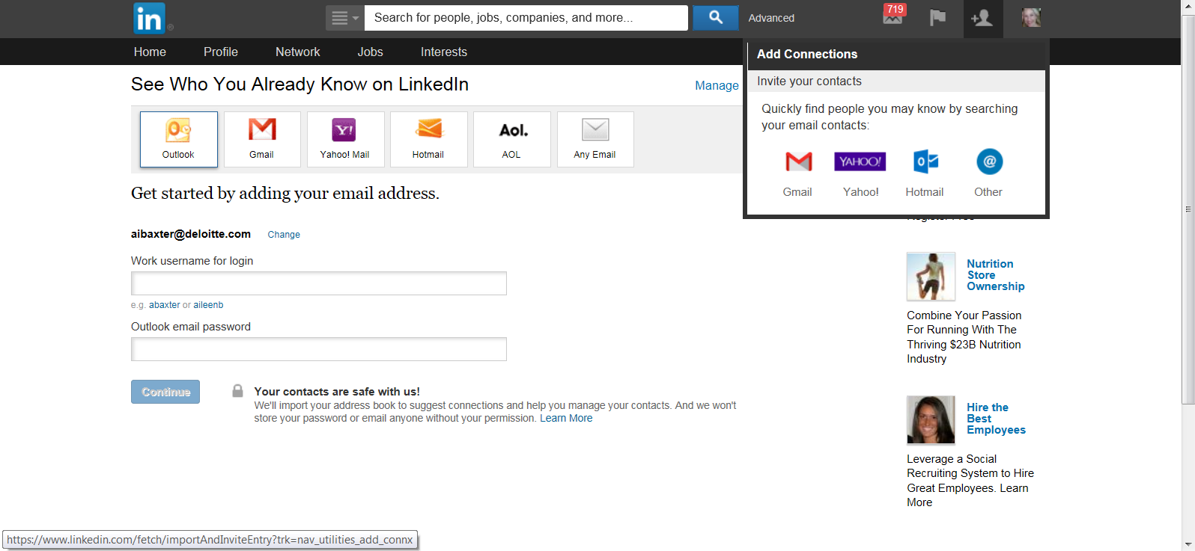
Building Your LinkedIn Network: Adding Connections

Slide 13
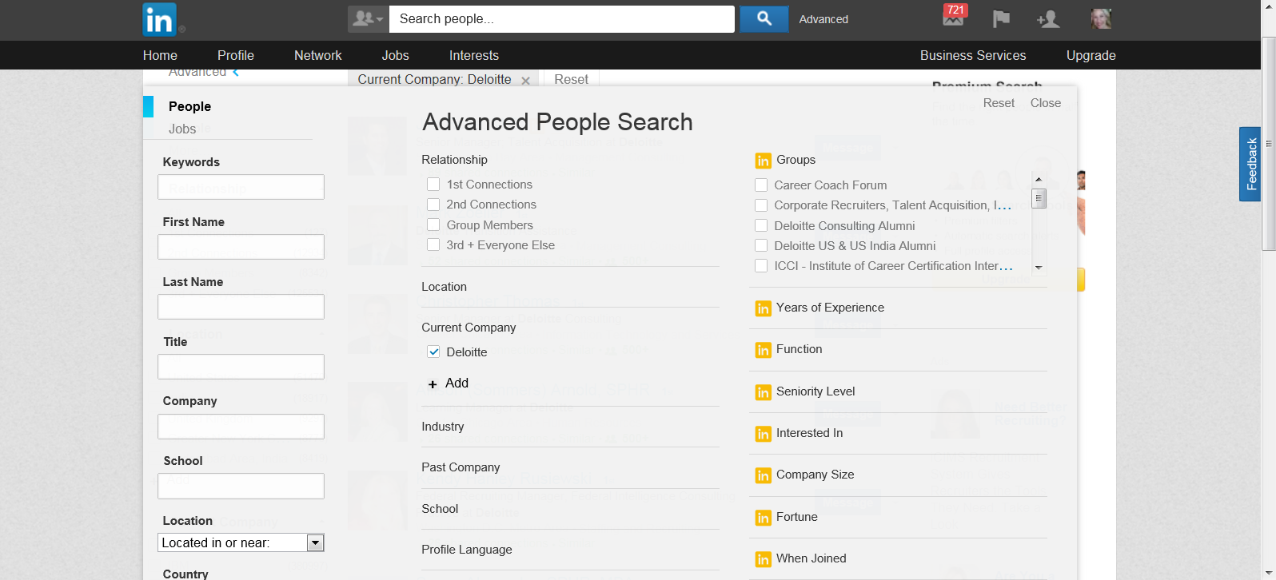
Building Your LinkedIn Network: Adding Connections

Slide 14
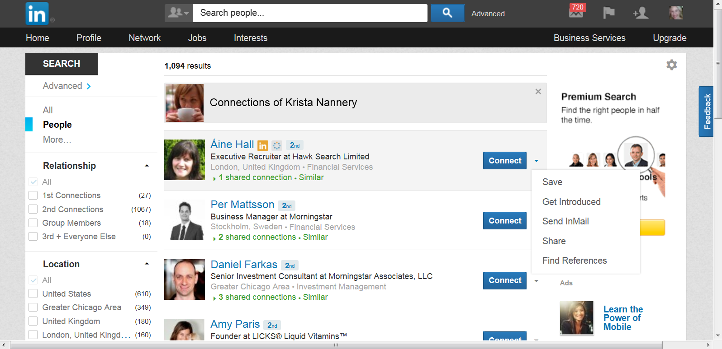
Building Your Network: Introductions

Slide 15
InMail
InMails are private messages that enable you to contact or be directly contacted by another LinkedIn user, while protecting the recipient's privacy. InMail is a paid feature that can be purchased individually or as a part of a premium account.
Allows you to contact individuals without being connected.
If you have a Basic (free) account, you can purchase InMail credits.
If you purchase a premium account, you are allotted a specific number of InMails based on the level (Business, Business Plus, Executive).
Other creative solutions:
First, check to see if the contact’s email address is public
Edit invitation text to make contact without expectation of connecting

Slide 16


Building your Group Membership
Reasons to join a group
Group members are an extension of your network and you may be able to contact them directly Connect with individuals with similar skills and interests Knowledge is power Recruiters source groups to find candidates Job opportunities are often shared within groups
Types of groups you may want to join
Professional groups Industry groups Skill groups Company groups Deloitte US (for current employees and alumni)
Reminder: LinkedIn allows you to join up to 50 groups

Slide 17
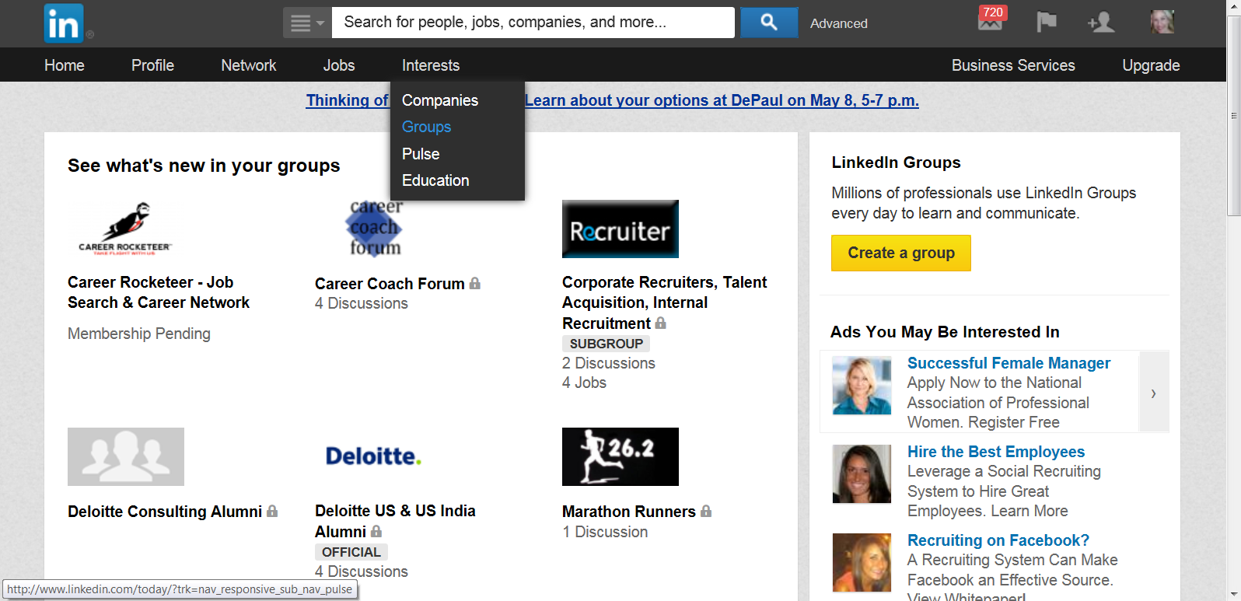
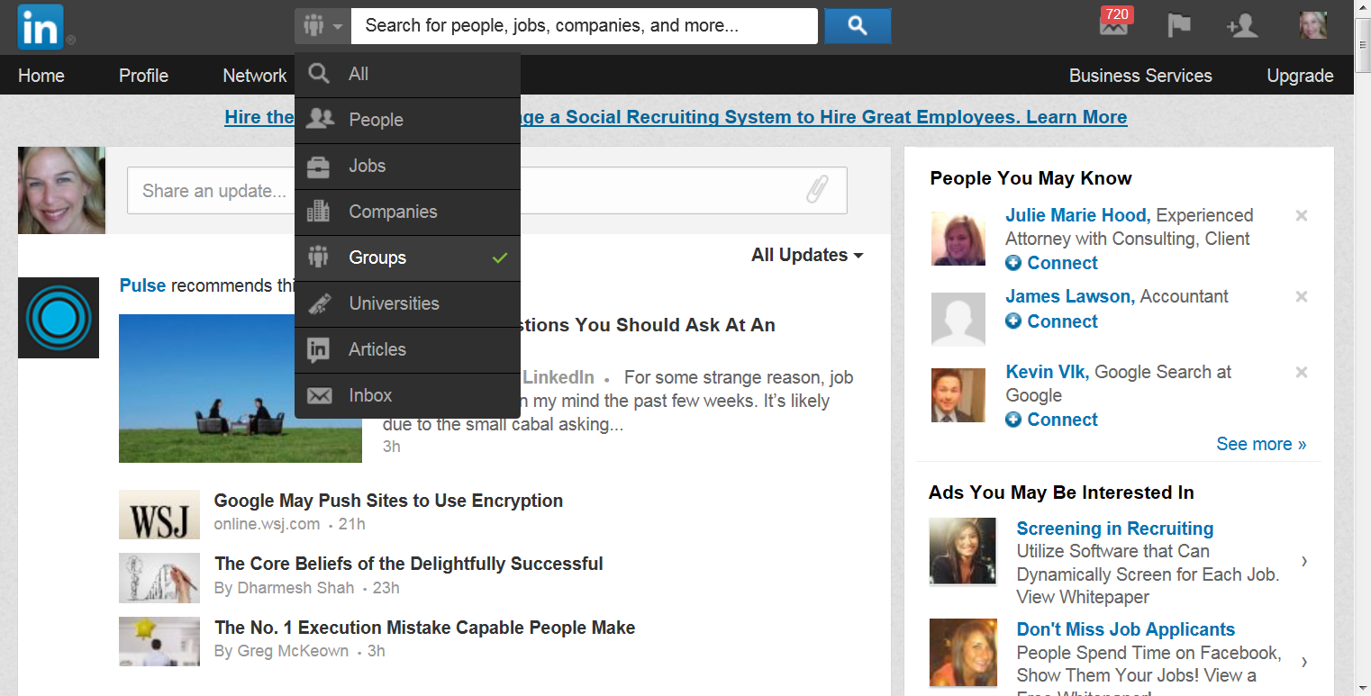
LinkedIn Groups

Slide 18
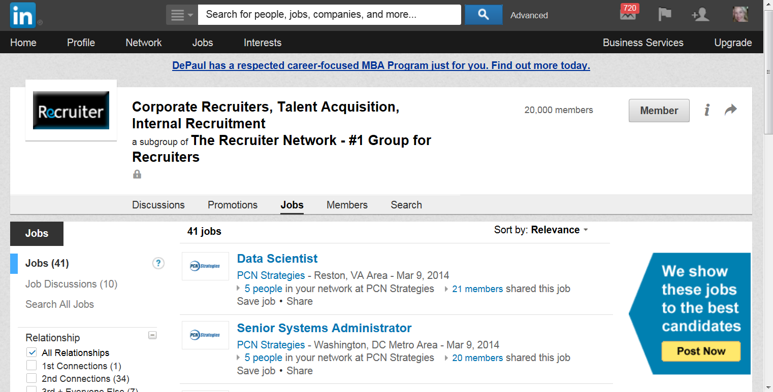
Search Jobs in Groups

Slide 19
Agenda
What is Linked In?
Build Your Profile
Build/Expand Your Network
Job Searching

Slide 20
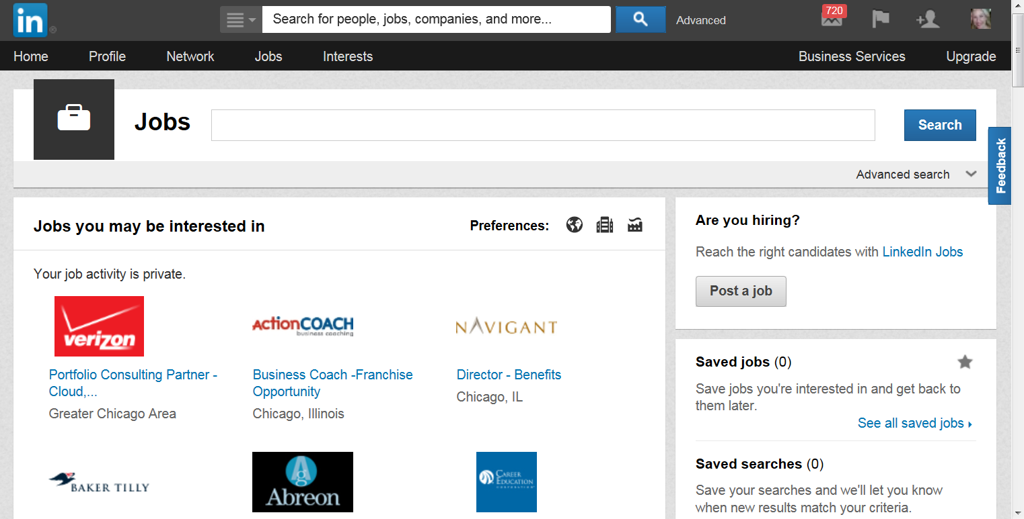
Search for Jobs

Slide 21
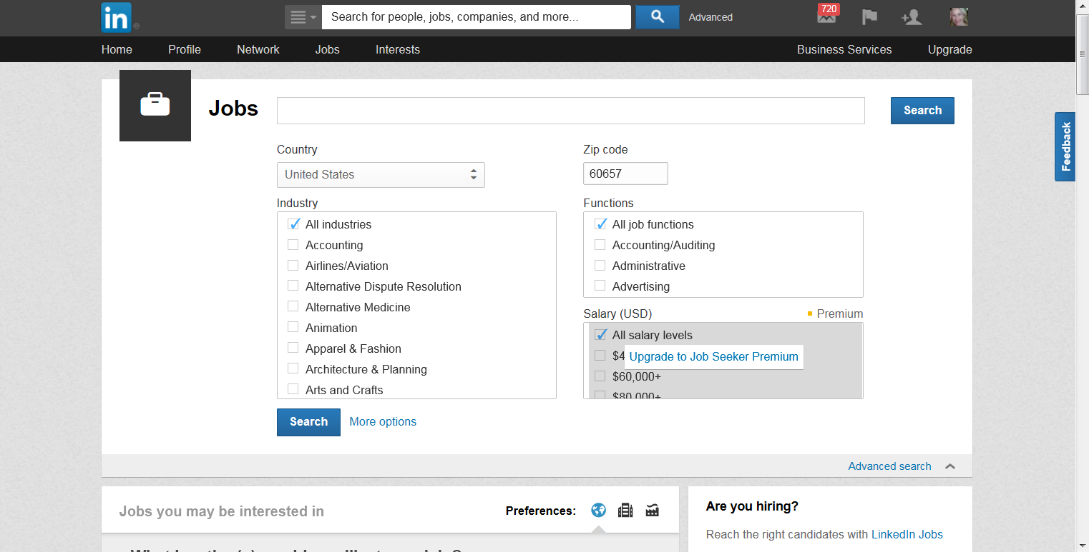
Advanced Job Search

Slide 22
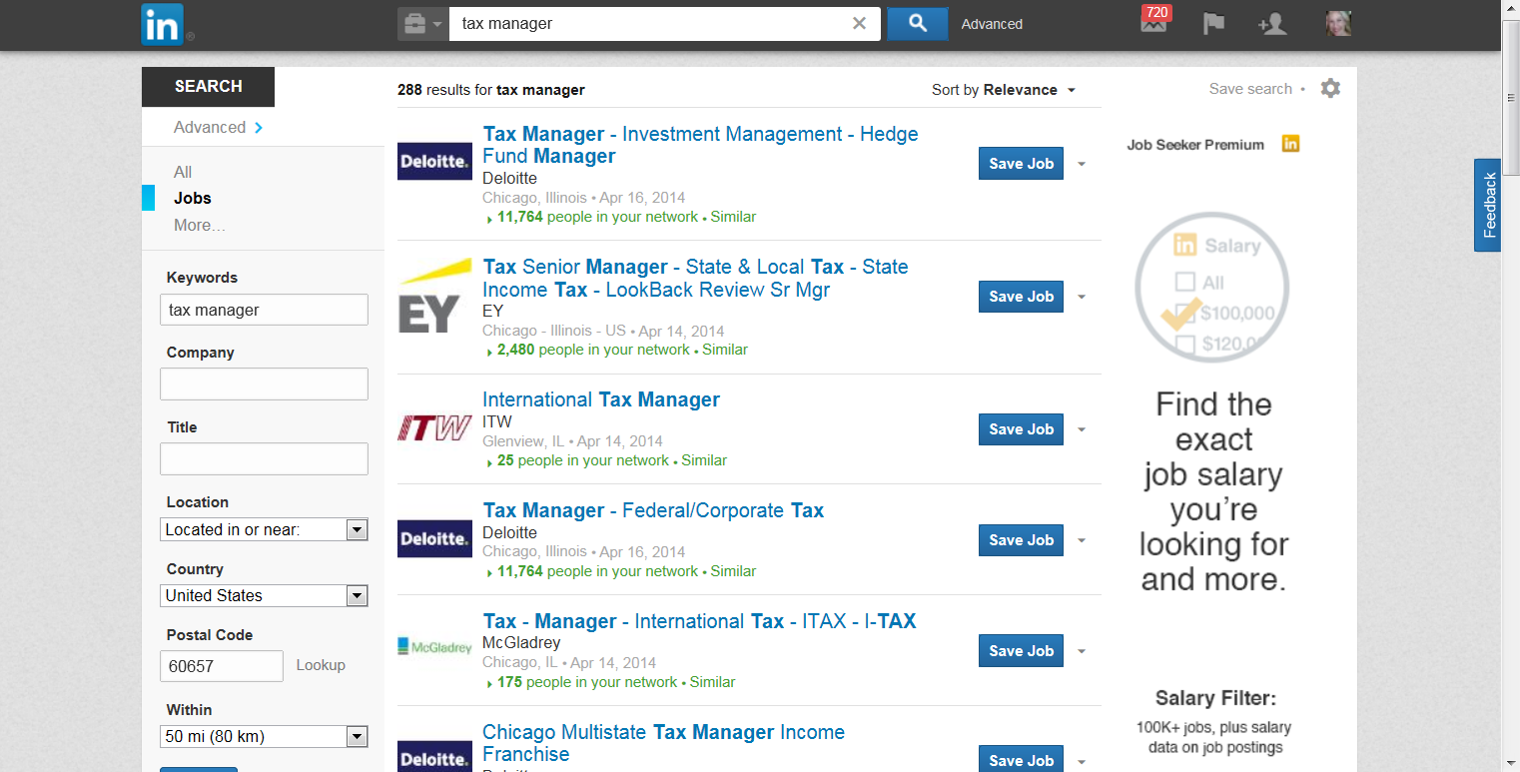
Job Search Results

Slide 23
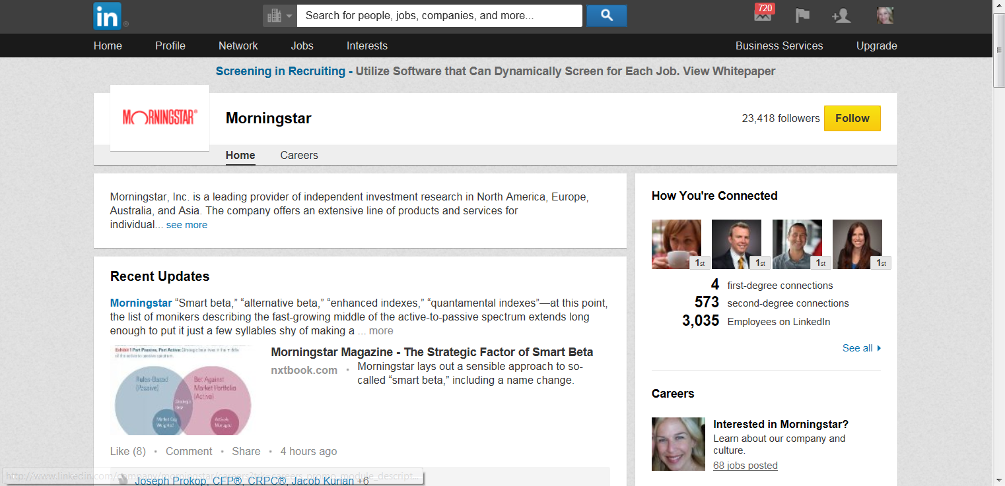
Companies: Research and Follow

Slide 24
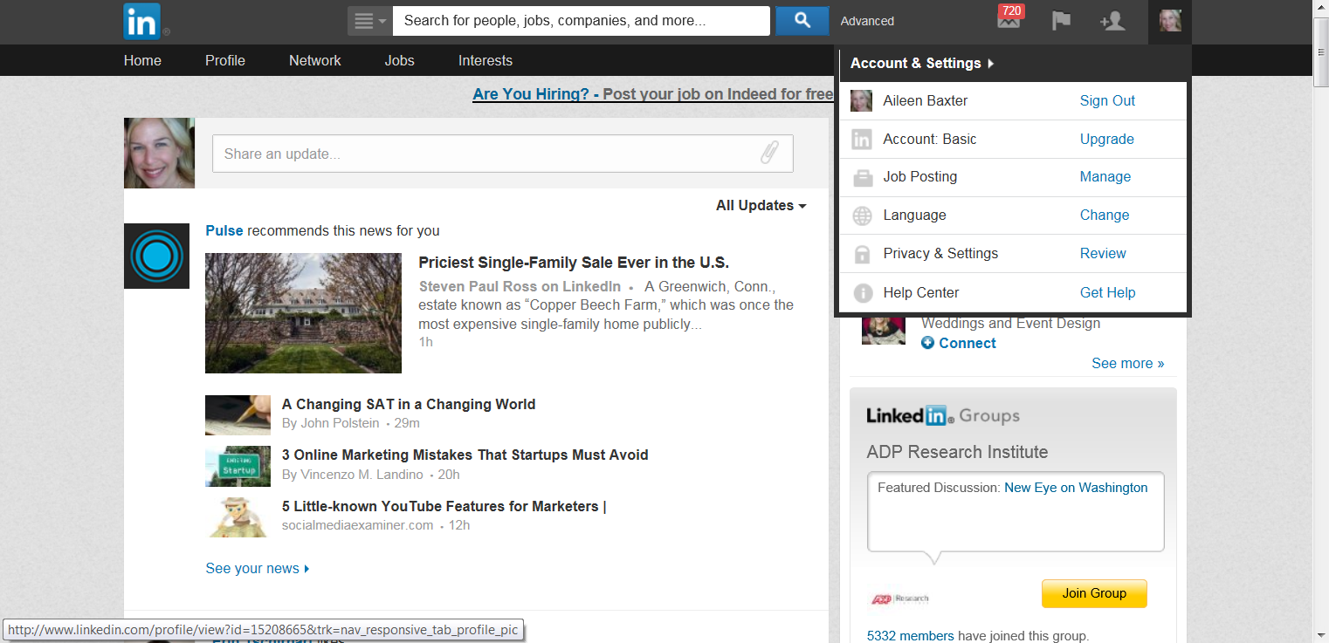
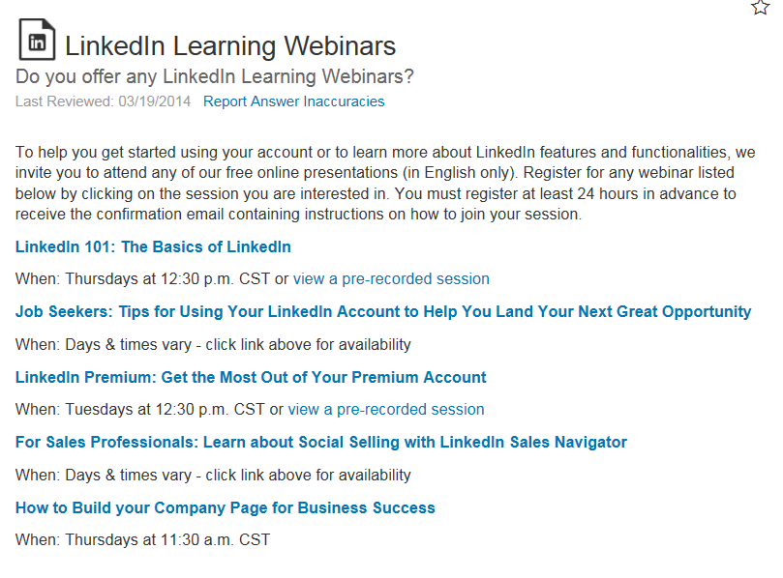
Linked In Tutorials/Webinars

Slide 25

Next Steps:
Update or refresh your profile
Join the Deloitte US Group
Add to your 1st level connections
Start Networking!
Copyright © 2012 Deloitte Development LLC. All rights reserved.

